Slide 1
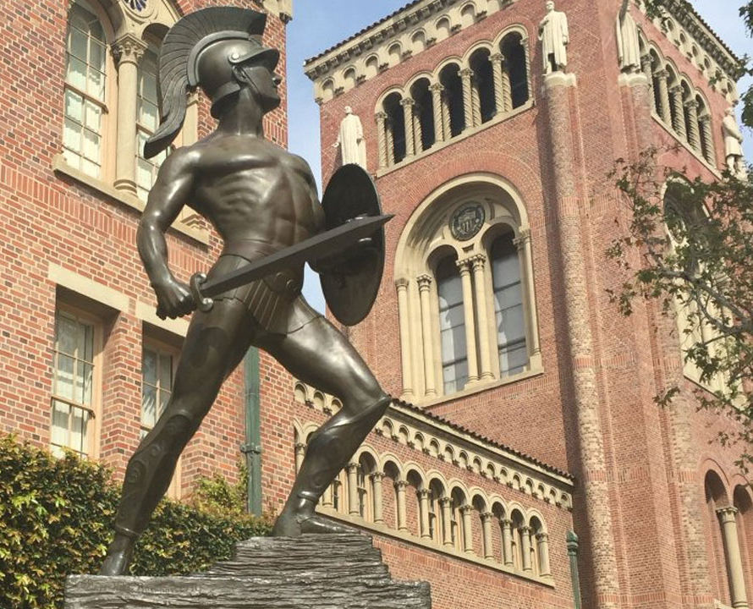
Trojan Map
EE599 Final Project, Spring 2021
by Haoxin Ma, Ziyou Geng

Slide 2
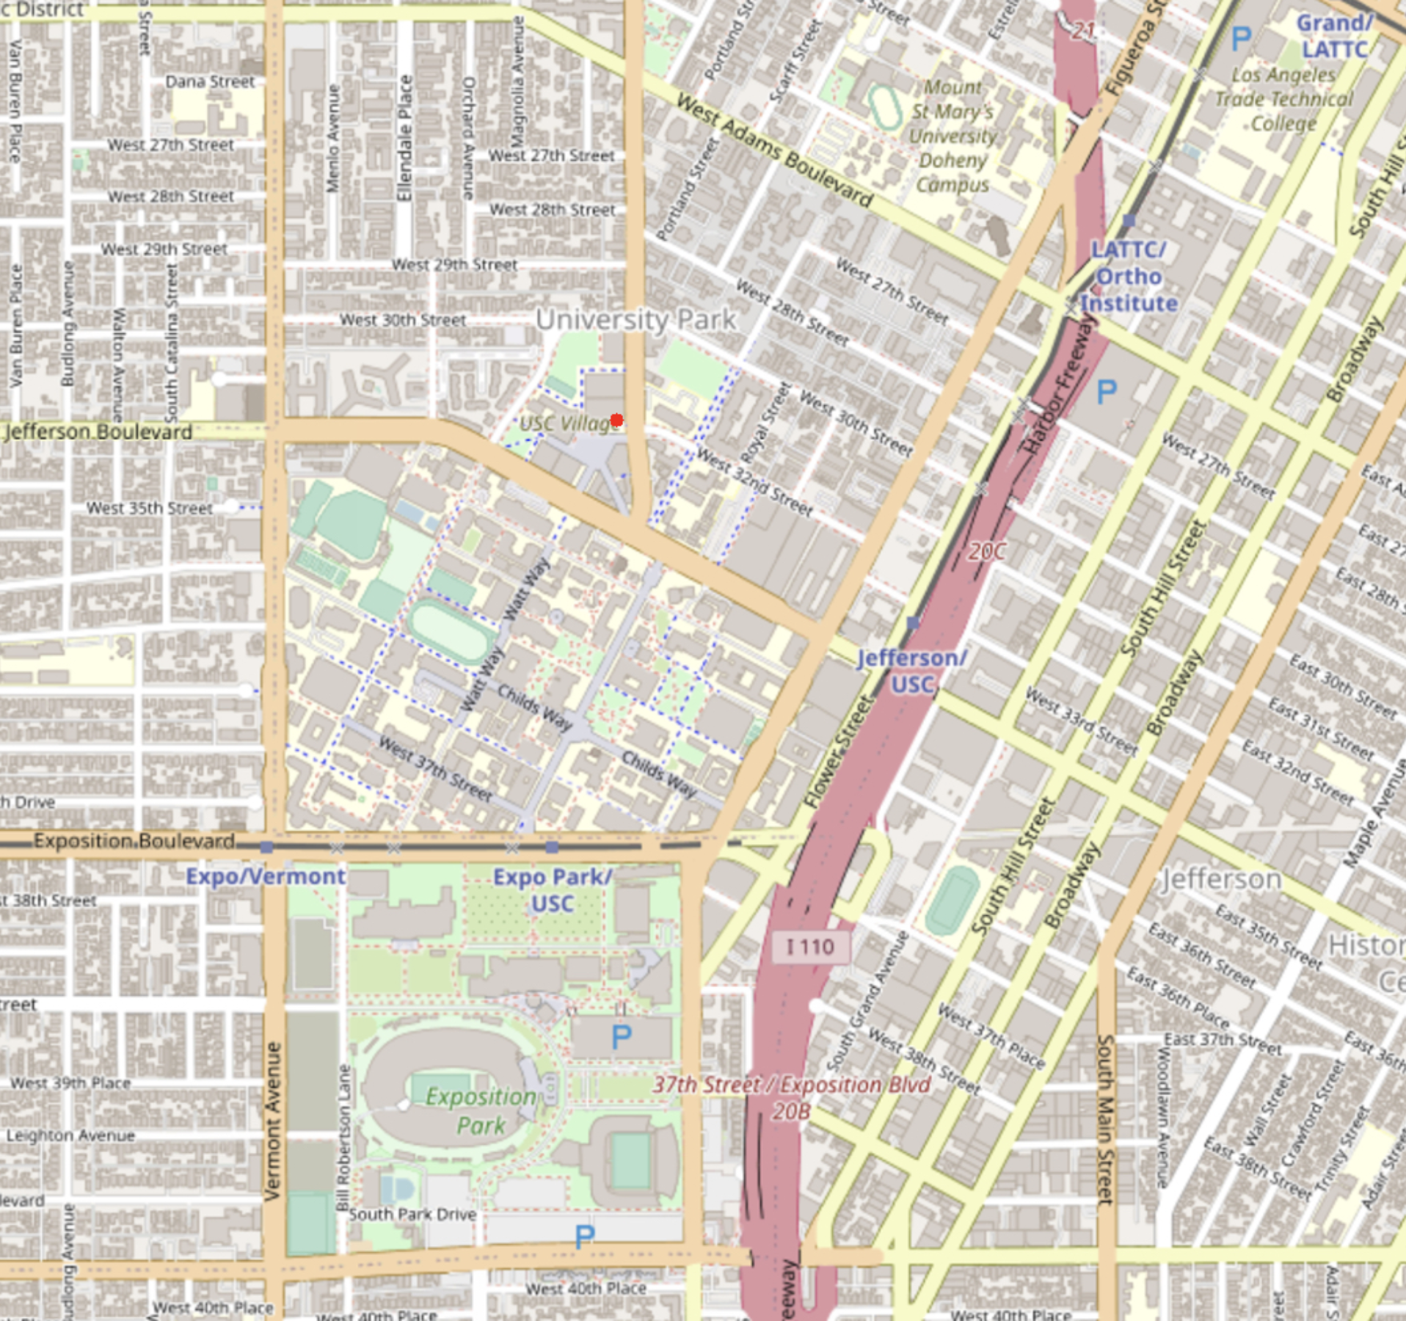
Outline
Autocomplete location names
Find Coordinates
Calculate Shortest Path
Dijkstra
Bellman-ford
Travelling Salesman Problem
Brute-force
2-opt
Cycle Detection
Topological Sort

Slide 3
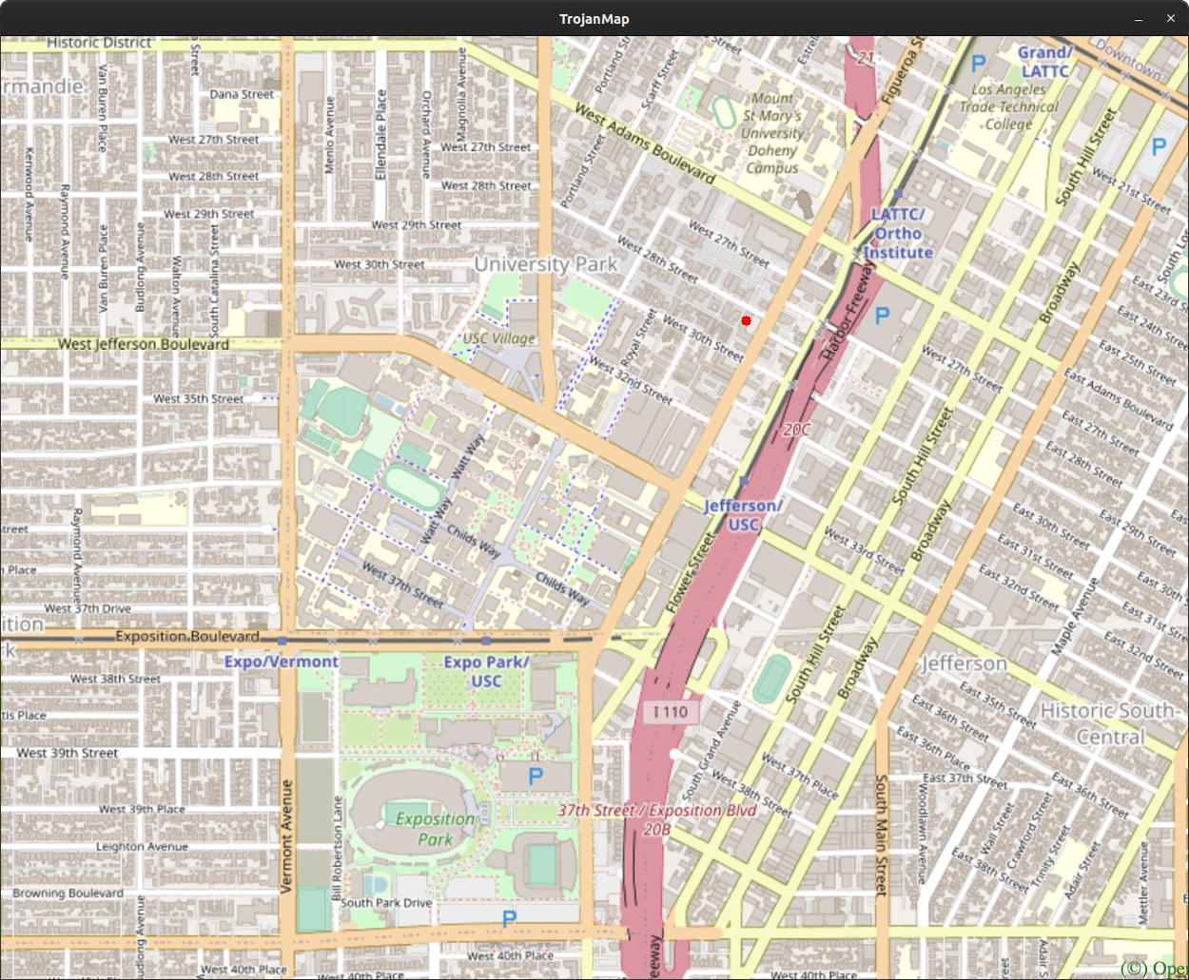
Autocomplete location names Find Coordinates
**************************************************************
* 1. Autocomplete
**************************************************************
Please input a partial location: K
*************************Results******************************
Kentucky Fried Chicken
Korean Presbyterian Church
Kobunga Korean Grill
Kaitlyn
**************************************************************
Please input a partial location: k
*************************Results******************************
Kentucky Fried Chicken
Korean Presbyterian Church
Kobunga Korean Grill
Kaitlyn
**************************************************************
Case Unsensitive

Slide 4
Calculate Shortest Path (Dijkstra)

Slide 5
Calculate Shortest Path (Bellman-Ford)
vector<string> TrojanMap::CalculateShortestPath_Bellman_Ford(string location1_name, string location2_name) {
vector<string> path;
string id1 = GetID(location1_name), id2 = GetID(location2_name);
if (id1 == "-1" || id2 == "-1") return path;
unordered_map<string, pair<string, double>> dis;
unordered_set<string> updated;
for (auto &pr : data) {
dis[pr.first] = make_pair("", DBL_MAX);
}
dis[id1].second = 0;
updated.insert(id1);
for (int i = 0; i < data.size() - 1; i++) {
unordered_set<string> updated_pre(updated);
updated.clear();
for (auto &id : updated_pre) {
for (auto &nb_id : data[id].neighbors) {
double new_dis = dis[id].second + CalculateDistance(data[id], data[nb_id]);
if (new_dis < dis[nb_id].second) {
dis[nb_id] = make_pair(id, new_dis);
updated.insert(nb_id);
}
}
}
if (updated.empty()) break;
}
string u_id = id2;
while (u_id != "") {
path.push_back(u_id);
u_id = dis[u_id].first;
}
reverse(path.begin(), path.end());
return path;
}

Slide 6
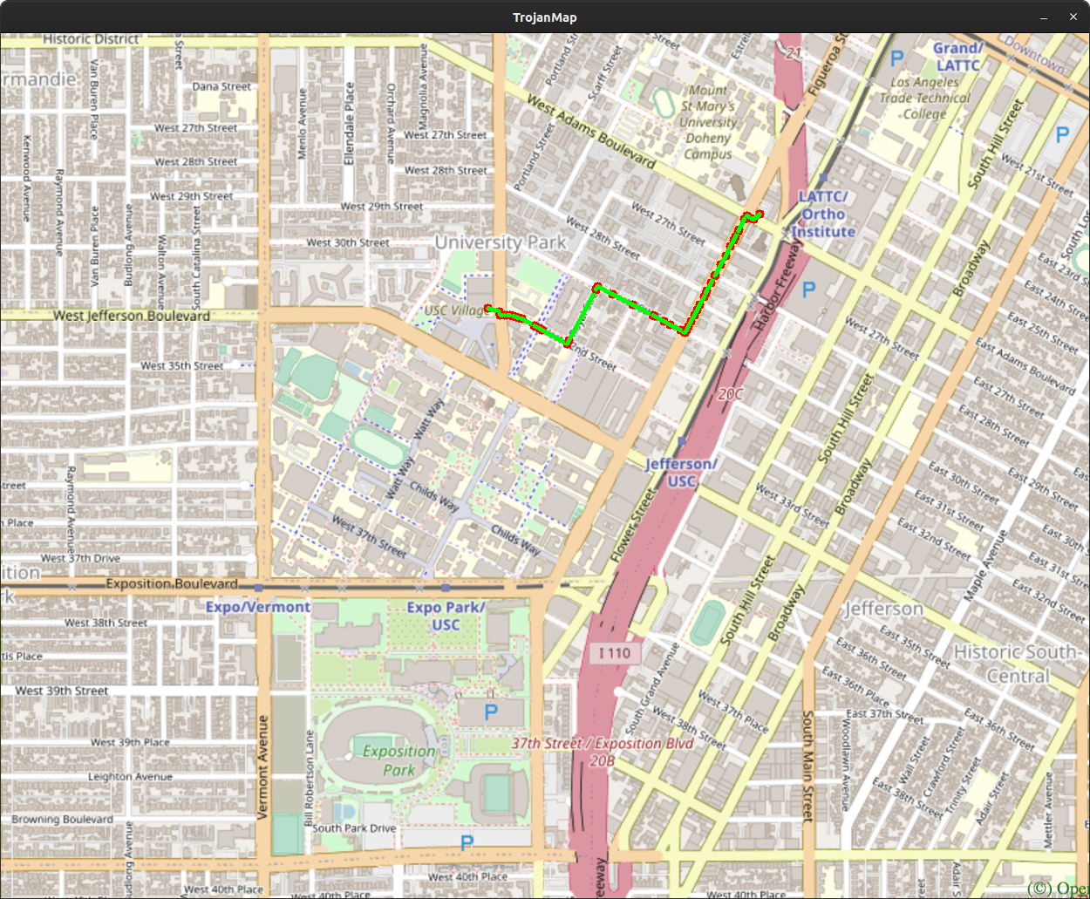
Calculate Shortest Path
e.g. Target -> Popeyes Louisiana Kitchen
Time taken by Bellman-Ford: 22176 microseconds

Slide 7
Travelling Salesman Problem (Brute-force)
pair<double, vector<vector<string>>> TrojanMap::TravellingTrojan(vector<string> &location_ids) {
vector<vector<string>> path;
vector<string> cur_path;
double min_dis = 0, cur_dis = 0;
TravellingTrojan_(location_ids, path, cur_path, cur_dis, min_dis);
return make_pair(min_dis, path);
}
void TrojanMap::TravellingTrojan_(vector<string> &ids, vector<vector<string>> &paths, vector<string> &cur_path,
double &cur_dis, double &min_dis) {
// each cur_path starts from ids[0]
if (cur_path.empty()) {
cur_dis = 0;
cur_path.push_back(ids[0]);
}
// each cur_path ends at ids[0]
if (cur_path.size() == ids.size()) {
double delta_dis = CalculateDistance(data[cur_path.back()], data[ids[0]]);
if (min_dis == 0 || cur_dis + delta_dis < min_dis) {
min_dis = cur_dis + delta_dis;
cur_path.push_back(ids[0]);
paths.push_back(cur_path); // save cur_path to path in descending order
cur_path.pop_back();
}
return;
}
// early backtracking
if (min_dis && cur_dis >= min_dis) {
return;
}
// iterate children
for (int i = 1; i < ids.size(); i++) {
if (find(cur_path.begin(), cur_path.end(), ids[i]) == cur_path.end()) {
double delta_dis = CalculateDistance(data[cur_path.back()], data[ids[i]]);
cur_dis += delta_dis;
cur_path.push_back(ids[i]);
TravellingTrojan_(ids, paths, cur_path, cur_dis, min_dis);
cur_path.pop_back();
cur_dis -= delta_dis;
}
}
}

Slide 8
Travelling Salesman Problem (2-opt)

Slide 9
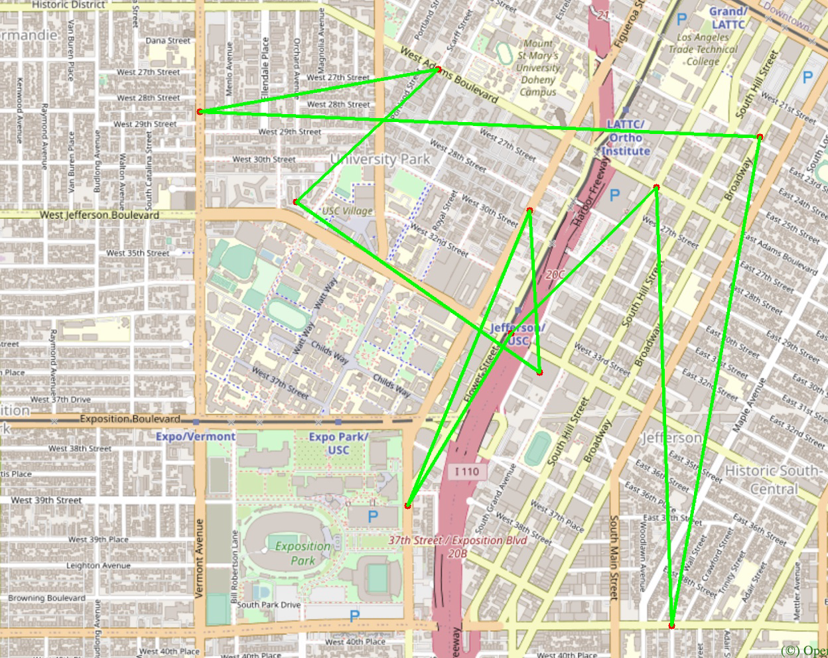
Travelling Salesman Problem
e.g. 10 random points
Time taken: 377549 microseconds

Slide 10
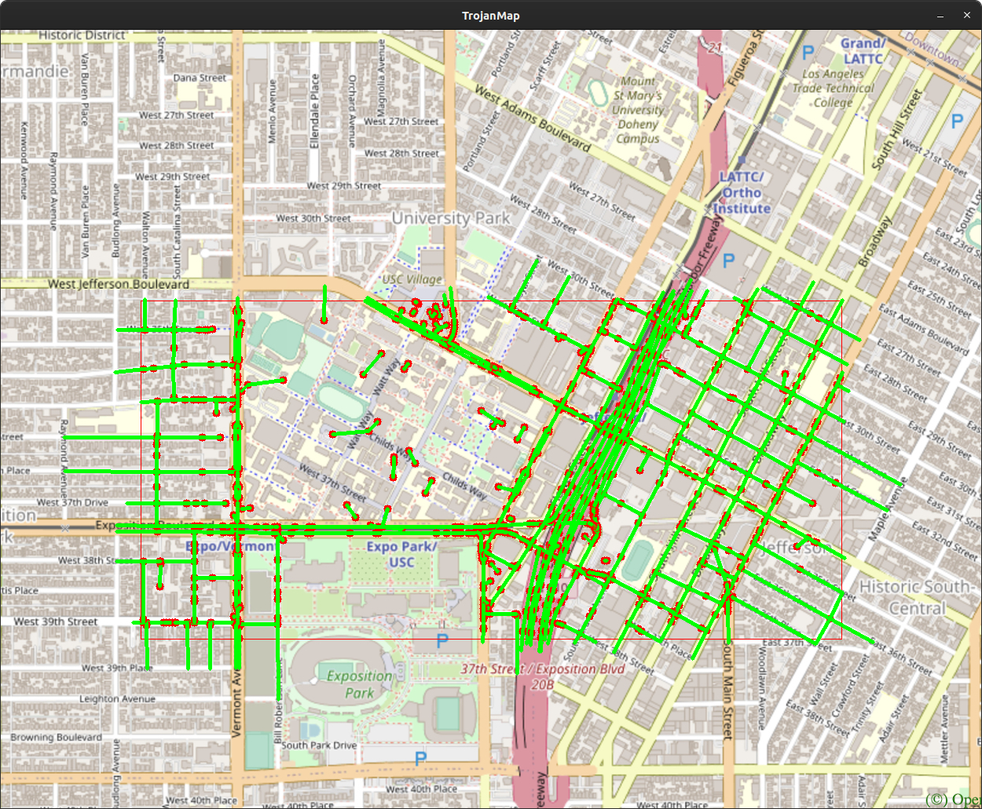
Cycle Detection
bool TrojanMap::CycleDetection(vector<double> &square) {
vector<string> location_ids;
for (auto &pr : data) {
if (pr.second.lon > square[0] && pr.second.lon < square[1] && pr.second.lat > square[3] &&
pr.second.lat < square[2])
location_ids.push_back(pr.first);
}
unordered_map<string, bool> visited;
for (auto id : location_ids) visited[id] = false;
for (auto id : location_ids) {
if (!visited[id]) {
string s; // null string
if (CycleDetection_(id, s, visited)) return true;
}
}
return false;
}
bool TrojanMap::CycleDetection_(string &id, string &parent, unordered_map<string, bool> &visited) {
visited[id] = true;
for (auto nb_id : data[id].neighbors) {
if (!visited[nb_id]) {
if (CycleDetection_(nb_id, id, visited)) return true;
} else if (visited[nb_id] && nb_id != parent) return true;
}
return false;
}
e.g. {-118.295, -118.27, 34.025, 34.015}
There exists at least one cycle in the subgraph
Time taken: 37350 microseconds

Slide 11
Topological Sort

Slide 12
What have we learned in this course?
C++ grammer (including some new features in C++11)
Advanced data structures and their algorithms
Linked list, stack, queue, tree, heap, graph...
Backtracking, dynamic programming...
Thinking in OOP
Special thanks to Prof. Arash Saifhashemi and Teaching Assistants

